Slide 1
Introduction to Python-Flask Webapp Framework
By
Dr. Thippeswamy M N
NMIT, Bangalore

Slide 2
Why Framework?
To build a complex webapp, you could roll-your-own (RYO) from scratch or build it over a framework (which defines the structure and provides a set of libraries for common tasks).
Rolling-your-own means that you need to write ten-thousand lines of boiler-plate codes, that are already provided by a framework. Worse still, your codes are most likely messy, buggy, un-tested and un-maintainable.
On the other hand, using a framework means that you need to spend weeks or even months reading and understanding the framework, as each framework has it own "syntax" and, hence, requires a steep learning curve.
Furthermore, there are just too many frameworks available and choosing the right framework turns out to be a difficult decision.
There are many Python frameworks available, e.g., full-stack frameworks like Djiango, TurboGears, web2py; non-full-stack frameworks like Flask, Pyramid. You need to make your own decision.

Slide 3
Python-Flask Framework
Flask was created by Armin Ronacher in 2000 as a small, minimalistic and light-weight Python Webapp framework. It is so small to be called a micro-framework.
Flask is actually a glue that sticks together two popular frameworks:
Werkzeug: a WSGI (Web Server Gateway Interface) library for Python, which includes a URL routing system, fully featured request and response objects and a powerful debugger. (WSGI is a specification for simple and universal interface between web servers and Python web applications.)
Jinja2: a full-feature template engine for Python.
High-level tasks like database access, web form and user authentication are supported through "extensions".

Slide 4
Within the scope of MVC (Model-View-Controller) architecture, Werkzeug covers the Controller (C) and Jinja2 covers the View (V). Flask does not provide an integrated Model (M) layer, and lets you pick your database solution. A popular choice is Flask-SQLAlchemy with a ORM (Object-Relational Mapper) over a relational database such as MySQL or PostgreSQL.
In summary, the Flask framework provides:
a WSGI compliance interface.
URL routing and Request dispatching.
Secure cookies and Sessions.
a built-in Development Web Server and Debugger.
Unit test client for unit testing that facilitates write-test-first.
Jinja2 templates (tags, filters, macros, etc).
Via Flask, you can handle HTTP and AJAX requests, user sessions between requests, route requests to controllers, evaluate and validate the request data, and response with HTML or JSON, and so on.

Slide 5
Installing Flask (under a Virtual Environment)
It is strongly recommended to develop Python application under a virtual environment. See "Virtual Environment".
Developing a flask application that has been built with your main Python installation can be a bad idea sometimes. Furthermore, it is not advisable to even start creating a web app using your main Python installation. Because you use Python for many other things, there can be a lot going in that installation.
Therefore, it would be good to have a clean environment that does not interfere with your main Python installation. The hero here is the venv library.
venv is a Python standard library that creates a virtual environment with an isolated Python installation. That installation will serve only to our flask web application, and not any other purposes. That will allow us to deploy a clean application to the online server.
venv comes shipped with Python so you don’t need to install it.

Slide 6
$ cd /path/to/project-directory # Choose your project directory
$ virtualenv -p python3 venv # For Python 3, or
$ virtualenv venv # For Python 2
$ source venv/bin/activate # Activate the virual environment (venv)
$ pip install flask # Install flask using 'pip' which is symlinked to pip2 or pip3 (no sudo needed)
Successfully installed Jinja2-2.9.5 MarkupSafe-0.23 Werkzeug-0.11.15 click-6.7 flask-0.12 itsdangerous-0.24 (venv)
$ pip show flask # Check installed packages
Name: Flask Version: 0.12
Summary: A microframework based on Werkzeug, Jinja2 and good intentions
Location: .../venv/lib/python3.5/site-packages Requires: Werkzeug, itsdangerous, click, Jinja2 (venv)
$ pip show Werkzeug
Name: Werkzeug Version: 0.11.15
Summary: The Swiss Army knife of Python web development Location: .../venv/lib/python3.5/site-packages Requires: (venv)
$ pip show Jinja2
Name: Jinja2 Version: 2.9.5
Summary: A small but fast and easy to use stand-alone template engine written in pure python.
Location: .../venv/lib/python3.5/site-packages Requires: MarkupSafe (venv)
$ deactivate # Exit virutal environment

Slide 7
Write a Hello-world Python-Flask Webapp
As an example, create a PyDev project called test-flask with a module called hello_flask (save as hello_flask.py), as follows:
# -*- coding: UTF-8 -*-
""" hello_flask: First Python-Flask webapp """
from flask import Flask # From module flask import class Flask
app = Flask(__name__) # Construct an instance of Flask class for our webapp
@app.route('/’) # URL '/' to be handled by main() route handler
def main():
"""Say hello"""
return 'Hello, world!’
if __name__ == '__main__': # Script executed directly?
app.run() # Launch built-in web server and run this Flask webapp

Slide 8
How It Works
Line 1 sets the source code encoding to UTF-8, recommended for internationalization (i18n). Lines 2 are the doc-string for the Python module.
In Line 3, we import the Flask class from the flask module. The from-import statement allows us to reference the Flask class directly (without qualifying with the module name as flask.Flask).
In Line 4, we create a new instance of Flask class called app for our webapp. We pass the Python's global variable __name__ into the Flask's constructor, which would be used to determine the root path of the application so as to locate the relevant resources such as templates (HTML) and static contents (images, CSS, JavaScript).
Flask handles HTTP requests via the so-called routes. The decorator @app.route(url) registers the decorated function as the route handler (or view function) for the url.
In Line 6-8, Flask registers the function main() as the route handler for the root url '/'. The return value of this function forms the response message for the HTTP request. In this case, the response message is just a plain text, but it would be in HTML/XML or JSON.

Slide 9
In Flask, the route handling function is called a view function or view. It returns a view for that route (quite different from the presentation view in MVC)?
The if __name__ == '__main__' ensures that the script is executed directly by the Python Interpreter (instead of being loaded as an imported module, where __name__ will take on the module name).
The app.run() launches the Flask's built-in development web server. It then waits for requests from clients, and handles the requests via the routes and route handlers.
You can press Ctrl-C to shutdown the web server.
The built-in developmental web server provided by Flask is not meant for use in production. I will show you how to run a Flask app under Apache web server later.

Slide 10
Run the Webapp
$ cd /path/to/project-directory
$ python hello_flask.py
Running on http://127.0.0.1:5000/ (Press CTRL+C to quit)
The Flask built-in web server has been started, listening on TCP port 5000. The webapp has also been started. It routes the URL '/' request to main() which returns the hello-world message.
In the web browser, type URL http://127.0.0.1:5000/ (or http://localhost:5000/) to trigger the webapp (localhost is the domain name for local loop-back IP address 127.0.0.1).
You should see the hello-world message.

Slide 11
(Advanced) Reloading Modified Source Code under WSGI
Reference: modwsgi Reloading Source Code @ https://code.google.com/p/modwsgi/wiki/ReloadingSourceCode.
If you modify your source code, running under WSGI, you need to restart the Apache server to reload the source code.
On the other hand, if you your WSGI process is run in so-called daemon mode (to verify, check if WSGIDaemonProcess is used in your apache configuration), you can reload the WSGI process by touching the .wsgi file.
By default, reloading is enabled and a change to the WSGI file will trigger the reloading. You can use the WSGIScriptReloading On|Off directive to control the reloading.

Slide 12
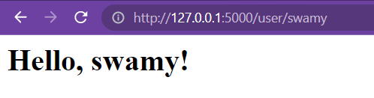
Example 2-2. hello.py: Flask application with a dynamic route
from flask import Flask
app = Flask(__name__)
@app.route('/hello')
def hello_world():
return 'Hello World'
@app.route('/user/<name>')
def user(name):
return '<h1>Hello, %s!</h1>' % name
if __name__ == '__main__':
app.run()

Slide 13
Routes and View Functions
Modern web frameworks use the routing technique to help a user remember application URLs.
It is useful to access the desired page directly without having to navigate from the home page.
The route() decorator in Flask is used to bind URL to a function. For example −
@app.route(‘/hello’)
def hello_world():
return ‘hello world’
Here, URL ‘/hello’ rule is bound to the hello_world() function. As a result, if a user visits http://localhost:5000/hello URL, the output of the hello_world() function will be rendered in the browser.

Slide 14
It is possible to build a URL dynamically, by adding variable parts to the rule parameter. This variable part is marked as <variable-name>. It is passed as a keyword argument to the function with which the rule is associated.
In the following example, the rule parameter of route() decorator contains <name> variable part attached to URL ‘/hello’.
Hence, if the http://localhost:5000/hello/TutorialsPoint is entered as a URL in the browser, ‘TutorialPoint’ will be supplied to hello() function as argument.

Slide 15
from flask import Flask
app = Flask(__name__)
@app.route('/hello/<name>')
def hello_name(name):
return 'Hello %s!' % name
if __name__ == '__main__':
app.run(debug = True)

Slide 16
Multiple Routes for the same Route Handler
You can register more than one URLs to the same route handler (or view function). For example,
@app.route('/’)
@app.route('/hello’)
def main():
"""Say Hello"""
return 'Hello, world!’
Restart the webapp.
Try issuing URL http://127.0.0.1:5000/ and http://127.0.0.1:5000/hello, and observe the result.

Slide 17
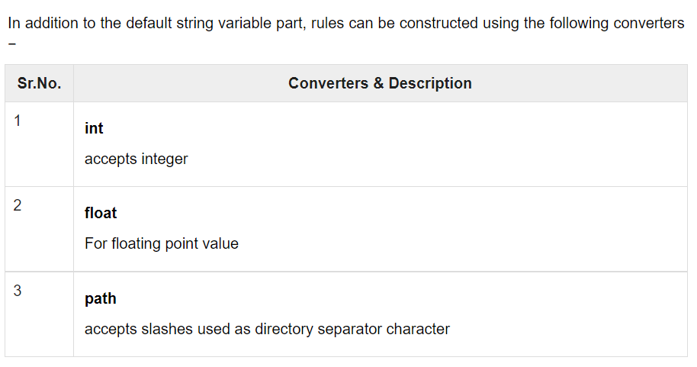

Slide 18
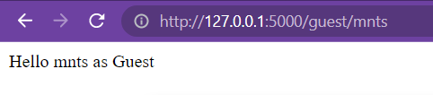
The url_for() function
The url_for() function is very useful for dynamically building a URL for a specific function. The function accepts the name of a function as first argument, and one or more keyword arguments, each corresponding to the variable part of URL.
The following script demonstrates use of url_for() function.
from flask import Flask, redirect, url_for
app = Flask(__name__)
@app.route('/admin')
def hello_admin():
return 'Hello Admin'
@app.route('/guest/<guest>')
def hello_guest(guest):
return 'Hello %s as Guest' % guest
@app.route('/user/<name>')
def hello_user(name):
if name =='admin':
return redirect(url_for('hello_admin'))
else:
return redirect(url_for('hello_guest',guest = name))
if __name__ == '__main__':
app.run(debug = True)

Slide 19
Templates:For example, consider a user who is registering a new account on a website. The user types an email address and a password in a web form and clicks the Submit button. On the server, a request that includes the data from the user arrives and Flask dispatches it to the view function that handles registration requests. This view function needs to talk to the database to get the new user added and then generate a response to send back to the browser.
These two types of tasks are formally called business logic and presentation logic, respectively
Moving the presentation logic into templates helps improve the maintainability of the application.
A template is a file that contains the text of a response, with placeholder variables for the dynamic parts that will be known only in the context of a request.
The process that replaces the variables with actual values and returns a final response string is called rendering.
For the task of rendering templates, Flask uses a powerful template engine called Jinja2.

Slide 20
Jinja2 Template Syntaxes
A Jinja2 template is simply a text file embedded with Jinja2 statements, marked by:
{# ...comment... #}: a comment not included in the template output.
{{ ...expression... }}: an expression (such as variable or function call) to be evaluated to produce the template output.
{% ...statement... %}: a Jinja2 statement.
You can use Jinja2 template to create any formatted text, including HTML, XML, Email, or MarkDown.
Jinja2 template engine is powerful. It supports variables, control constructs (conditional and loop), and inheritance. Jinja2 syntaxes closely follow Python.

Slide 21
The Jinja2 Template Engine
In its simplest form, a Jinja2 template is a file that contains the text of a response.
Example 3-1 shows a Jinja2 template that matches the response of the index() view function of Example 2-1.
Example 3-1. templates/index.html: Jinja2 template
<h1>Hello World!</h1>
The response returned by view function user() of Example 2-2 has a dynamic component, which is represented by a variable.
Example 3-2 shows the template that implements this response.
Example 3-2. templates/user.html: Jinja2 template
<h1>Hello, {{ name }}!</h1>
Example 2-1. hello.py: A complete Flask application from flask import Flask
app = Flask(__name__) @app.route('/’)
def index():
return 'Hello World!
' if __name__ == '__main__': app.run(debug=True)

Slide 22
Variables
Template variables are bound by the so-called context dictionary passed to the template. They can be having a simple type (such as string or number), or a complex type (such as list or object). You can use an expression {{ jinja2-varname }} to evaluate and output its value.
The following flask's variables/functions are available inside the Jinja2 templates as:
config: the flask.config object.
request: the flask.request object.
g: the flask.g object, for passing information within the current active request only.
session: the flask.session object, for passing information from one request to the next request for a particular user.
url_for(): the flask.url_for() function.
get_flashed_message(): the flask.get_flashed_message() function.

Slide 23
Testing Jinja2 Syntaxes
You can test Jinja2 syntaxes without writing a full webapp by constructing a Template instance and invoking the render() function. For example,
# Import Template class
>>> from jinja2 import Template
# Create a Template containing Jinja2 variable
>>> t = Template('Hello, {{ name }}’)
# Render the template with value for variable
>>> t.render(name='Peter’)
'Hello, Peter'

Slide 24
Jinja2's Filters
You can modify a value by piping it through so called filter, using the pipe symbol ('|') in the form of {{ varname|filter-name }}, e.g.,
>>> from jinja2 import Template
>>> t1 = Template('Hello, {{ name|striptags }}’)
>>> t1.render(name='<em>Peter</em>’)
'Hello, Peter' # HTML tags stripped
>>> t2 = Template('Hello, {{ name|trim|title }}’)
>>> t2.render(name=' peter and paul ‘)
'Hello, Peter And Paul’ # Trim leading/trailing spaces and initial-cap each word

Slide 25
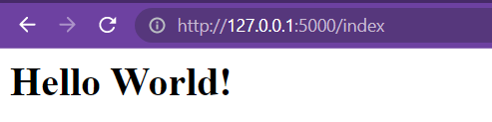
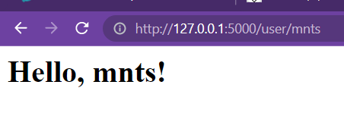
Rendering Templates
By default Flask looks for templates in a templates subfolder located inside the application folder. For the next version of hello.py, you need to store the templates defined earlier in a new templates folder as index.html and user.html.
The view functions in the application need to be modified to render these templates.
Example 3-3 shows these changes.

Slide 26
from flask import Flask, render_template
app = Flask(__name__)
@app.route('/index')
def index():
return render_template('index.html')
@app.route('/user/<name>')
def user(name):
return render_template('user.html', name=name)
if __name__ == '__main__':
app.run()
The {{ name }} construct used in the template shown in Example 3-2 references a variable, a special placeholder that tells the template engine that the value that goes in that place should be obtained from data provided at the time the template is rendered

Slide 27
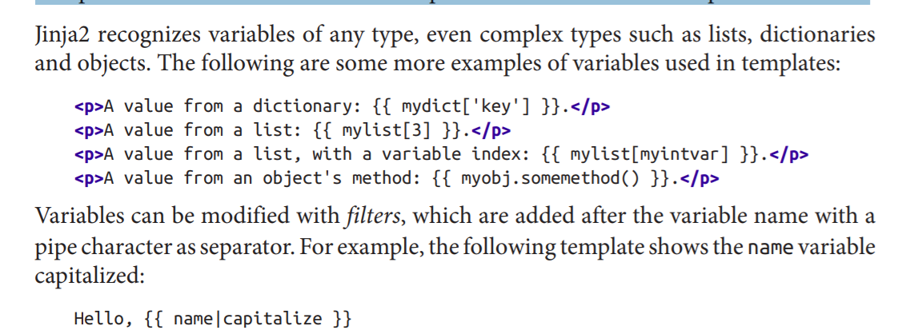
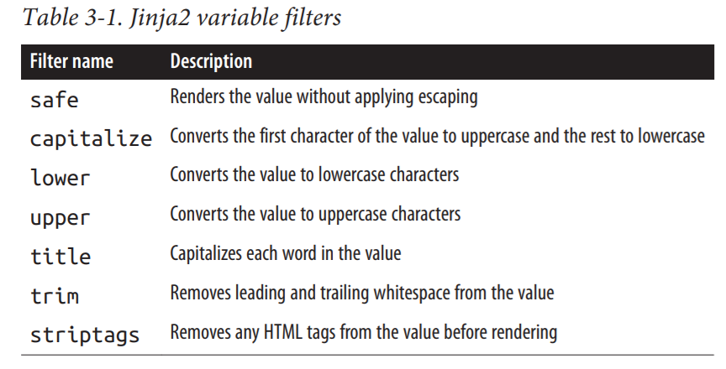

Slide 28
Control Structures
Jinja2 offers several control structures that can be used to alter the flow of the template.
This section introduces some of the most useful ones with simple examples.
The following example shows how conditional statements can be entered in a template:
{% if user %}
Hello, {{ user }}!
{% else %}
Hello, Stranger!
{% endif %}
Another common need in templates is to render a list of elements. This example shows how this can be done with a for loop:
<ul>
{% for comment in comments %}
<li>{{ comment }}</li>
{% endfor %}
</ul>

Slide 29
In the following example, use of conditional statement in the template is demonstrated. The URL rule to the hello() function accepts the integer parameter. It is passed to the hello.html template. Inside it, the value of number received (marks) is compared (greater or less than 50) and accordingly HTML is conditionally rendered.
from flask import Flask, render_template
app = Flask(__name__)
@app.route('/hello/<int:score>')
def hello_name(score):
return render_template('hello.html', marks = score)
if __name__ == '__main__':
app.run(debug = True)

Slide 30
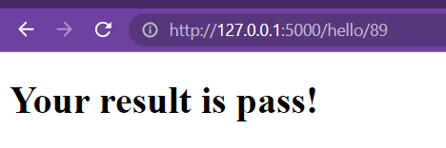
HTML template script of hello.html is as follows −
<!doctype html>
<html>
<body>
{% if marks>50 %}
<h1> Your result is pass!</h1>
{% else %}
<h1>Your result is fail</h1>
{% endif %}
</body>
</html>

Slide 31
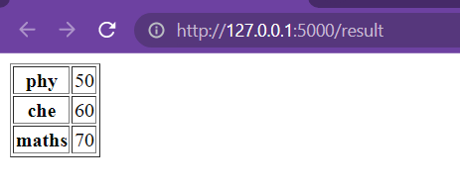
The Python loop constructs can also be employed inside the template. In the following script, the result() function sends a dictionary object to template results.html when URL http://localhost:5000/result is opened in the browser. The Template part of result.html employs a for loop to render key and value pairs of dictionary object result{} as cells of an HTML table. Run the following code from Python shell.
from flask import Flask, render_template
app = Flask(__name__)
@app.route('/result')
def result():
dict = {'phy':50,'che':60,'maths':70}
return render_template('result.html', result = dict)
if __name__ == '__main__':
app.run(debug = True)
<!doctype html>
<html>
<body>
<table border = 1>
{% for key, value in result.items() %}
<tr>
<th> {{ key }} </th>
<td> {{ value }} </td>
</tr>
{% endfor %}
</table>
</body>
</html>

Slide 32
Jinja2 Template Engine
In Flask, the route handlers (or view functions) are primarily meant for the business logic (i.e., Controller in MVC), while the presentation (i.e., View in MVC) is to be taken care by the so-called templates. A template is a file that contains the static texts, as well as placeholder for rendering dynamic contents.
Flask uses a powerful template engine called Jinja2.

Slide 33
Getting Started in Jinja2 Templates with HTML Forms
templates/j2_query.html
<!DOCTYPE html>
<html lang="en">
<head> <meta charset="utf-8"> <title>Entry Page</title> </head>
<body>
<form action="process" method="post">
<label for="username">Please enter your name: </label>
<input type="text" id="username" name="username"><br>
<input type="submit" value="SEND">
</form>
</body>
</html>

Slide 34
templates/j2_response.html
<!DOCTYPE html>
<html lang="en">
<head>
<meta charset="utf-8">
<title>Response Page</title>
</head>
<body>
<h1>Hello, {{ username }}</h1>
</body>
</html>

Slide 35
Create the main script hello_jinja2.py under your project directory, as follows:
# -*- coding: UTF-8 -*- """ hello_jinja2: Get start with Jinja2 templates """
from flask import Flask, render_template, request
app = Flask(__name__)
@app.route('/’)
def main():
return render_template('j2_query.html’)
@app.route('/process', methods=['POST’])
def process(): # Retrieve the HTTP POST request parameter value from 'request.form' dictionary
_username = request.form.get('username’) # get(attr) returns None if attr is not present
# Validate and send response
if _username:
return render_template('j2_response.html', username=_username)
else:
return 'Please go back and enter your name...', 400 # 400 Bad Request
if __name__ == '__main__’:
app.run(debug=True)

Slide 36
The piping operation {{ name|trim|title }} is the same as function call title(trim(name)). Filters can also accept arguments, e.g. {{ mylist|join(', ') }}, which is the same as str.join(', ', mylist).
The commonly-used built-in filters are:
upper: to uppercase & lower: to lowercase
capitalize: first character in uppercase, the rest in lowercase & title: initial-capitalize each word
trim: strip leading and trailing white-spaces
striptags: remove all HTML tags
default('default-value'): provides the default value if the value is not defined, e.g.
>>> from jinja2 import Template
>>> t = Template('{{ var|default("some default value") }}’)
>>> t.render() 'some default value’x
>>> t.render(var='some value') 'some value'
safe: output without escaping HTML special characters. See the section below.
tojson: convert the given object to JSON representation. You need to coupled with safe to disable autoescape, e.g., {{ username|tojson|safe }}.

Slide 37
Assignment and set Statement
You can create a variable by assigning a value to a variable via the set statement, e.g.,
{% set username = 'Peter' %}
{% set navigation = [('index.html', 'Index'), ('about.html', 'About')] %}
{% set key, value = myfun() %}
Conditionals
The syntax is:
{% if ...... %}
......
{% elif ...... %}
......
{% else %}
......
{% endif %}

Slide 38
For example,
# -*- coding: UTF-8 -*-
from jinja2 import Template
t = Template('’’
{% if name %}
Hello, {{ name }}
{% else %}
Hello, everybody
{% endif %}'’’)
print(t.render(name='Peter’)) # 'Hello, Peter’
print(t.render()) # 'Hello, everybody'

Slide 39
Loops: Jinja2 support for-in loop.
The syntax is:
{% for item in list %}
......
{% endfor %}
For example, to generate an HTML list:
# -*- coding: UTF-8 -*-
from jinja2 import Template
t = Template('’’ <ul> {% for message in messages %}
<li>{{ message }}</li>
{% endfor %}
</ul>’’’)
print(t.render(messages=['apple', 'orange', 'pear’]))
The output is:
<ul>
<li>apple</li><li>orange</li><li>pear</li>
</ul>

Slide 40
The Variable loop
Inside the loop, you can access a special variable called loop, e.g.,
loop.first: first iteration?
loop.last: last iteration?
loop.cycle('str1', 'str2', ...): print str1, str2,... alternating
loop.index: 1-based index
loop.index0: 0-based index
loop.revindex: reverse 1-based index
loop.revindex0: reverse 0-based index

Slide 41
For example:
# -*- coding: UTF-8 -*-
from jinja2 import Template
t = Template('’’
<ul>
{% for item in items %}
<li>{% if loop.first %}THIS IS ITEM 1{% endif %}
{{ loop.index }}: {{ item }} ({{ loop.cycle('odd', 'even') }})</li>
{% endfor %}
</ul>'’’)
print(t.render(items=['apple', 'banana', 'cherry’]))
The output is:
<ul>
<li> THIS IS ITEM 1 1: apple (odd)</li>
<li> 2: banana (even)</li>
<li> 3: cherry (odd)</li>
</ul>

Slide 42
with block-scope variable
You can create block-scope variable using the with statement, e.g.,
{% with messages = get_flashed_messages() %}
{% if messages %}
<ul class='flashes’>
{% for message in messages %}<li>{{ message }}</li>{% endfor %} </ul>
{% endif %}
{% endwith %}
The variable message is only visible inside the with-block.
Take note that with belongs to Jinja2 extension, and may not be available by default.

Slide 43
Jinja2's url_for() Function
The url_for(view_function_endpoint) helper function, which returns the URL for the given view function (route handler), works in Jinja2 template as well.
In Flask, the static resources, such as images, css, and JavaScripts are stored in a sub-directory called static, by default, with sub-sub-directories such as img, css, js. The routes for these static files are /static/<filename> (as shown in the app.url_map).
url_for('static', filename='css/mystyles.css', _external=True): return the external URL http://localhost:5000/static/css/mystyles.css.
For example, to include an addition CSS in the head_section block:
{% block head_section %}
{{ super() }}
<link rel="stylesheet" href="{{ url_for('static', filename='css/mystyles.css') }}">
{% endblock %}

Slide 44
Web Forms via Flask-WTF and WTForms Extensions
Recall that we can use request.form, request.args, request.values and request.get_json() to retrieve the request data. However, there are many repetitive and tedious task in handling form input data, in particular, input validation. The Flask-WTF extension greatly simplifies form processing, such as generating HTML form codes, validating submitted data, cross-site request forgery (CSRF) protection, file upload, and etc.
Installing Flask-WTF (under virtual environment)
$ cd /path/to/project-directory
$ source venv/bin/activate # Activate the virual environment (venv)
$ pip install flask-wtf Successfully installed WTForms-2.1 flask-wtf-0.14.2 (venv)$ pip show flask-wtf Name: Flask-WTF Version: 0.14.2 Location: .../venv/lib/python3.5/site-packages Requires: Flask, WTForms (venv)$ pip show WTForms Name: WTForms Version: 2.1 Location: .../venv/lib/python3.5/site-packages Requires:

